Slide 1

Credit Worthiness

Slide 2
Contents
Problem Statement
Feature Description
Data Exploration
Models selected
Results
Conclusion

Slide 3
What is Credit worthiness
Creditworthiness is the parameter that decides whether a person or company will be considered to be worthy or deserving to be given financial credit for certain period of time based on their previous repayment history
Financial institutions uses credit score for evaluating and quantifying to decide that an applicant is worthy to be given credit
The worth obtained using creditworthiness is used to decide the interest rates on credit and credit limit (the amount to be sanctioned) for the existing borrower.

Slide 4
Problem Statement
Based on the given data and available features, we need to
To take credit decisions based on individual characteristics
Give early warning to potential credit defaults

Slide 5
Feature description
There are 21 feature including credit score. We will take 20 features as input features and credit score as our target feature.
Do not worry about feature selection here because we are using regularization which automatically select the important features required to model the credit score and make the coefficient of nonimportant features as zero.

Slide 6
Feature description
Variables | Data Type | Description
Cbal | CATEGORICAL | Balance in the checking account in Rs. (rupees) but as part of categories
Cdur | NUMERICAL | The duration of the credit in months (numerical)
Chist | CATEGORICAL | The pattern of credit dues payment over time, whether the borrower has paid his monthly dues promptly , has fallen behind currently or in the past, or in a critical state.
Cpur | CATEGORICAL | Purpose of the loan – for a variety of needs from vehicles, furniture to housing
Camt | NUMERICAL | The actual amount under credit/loan in Rs. (rupees) (numerical)
Sbal | CATEGORICAL | Balance in the savings bank account in Rs. (rupees) but as part of categories
Edur | CATEGORICAL | Duration of employment, need to understand from borrower's background if he is unemployed or employed, if employed then for how many years.
InRate | NUMERICAL | The instalment rate provided as percentage of disposable income (we do not know what the disposable income could mean here and is best to take the rate as is.) (numerical)
MSG | CATEGORICAL | MSG (marital status and gender) informs us on the person’s gender and current status.
Oparties | CATEGORICAL | Other parties i.e. the presence of a guarantor or co-applicant to the loan/credit
Rdur | CATEGORICAL | Duration in current residence in years but as part of categories
Prop | CATEGORICAL | Other properties that the person possess. Note : Person could possess a car/similar property in addition to the ones under Cpur
Age | NUMERICAL | Age of the borrower
InPlans | CATEGORICAL | Other instalment plans that the borrower may have i.e from another bank or stores
Htype | CATEGORICAL | Type of housing, whether the borrower owns the property, pays rent or lives for free.
NumCred | NUMERICAL | Number of existing credits at the bank (numerical)
JobType | CATEGORICAL | Type of job the borrower is employed in whether skilled or unskilled, management or self employed etc.
Ndepend | NUMERICAL | Number of dependents (numerical)
Tel | CATEGORICAL | If the borrower has a telephone number or not ?
Foreign | CATEGORICAL | If the borrower is foreign worker or not ?
CreditScore | CATEGORICAL | Chances of borrower closing his credit promptly, Categorised as ‘Good’ and ‘Bad’

Slide 7
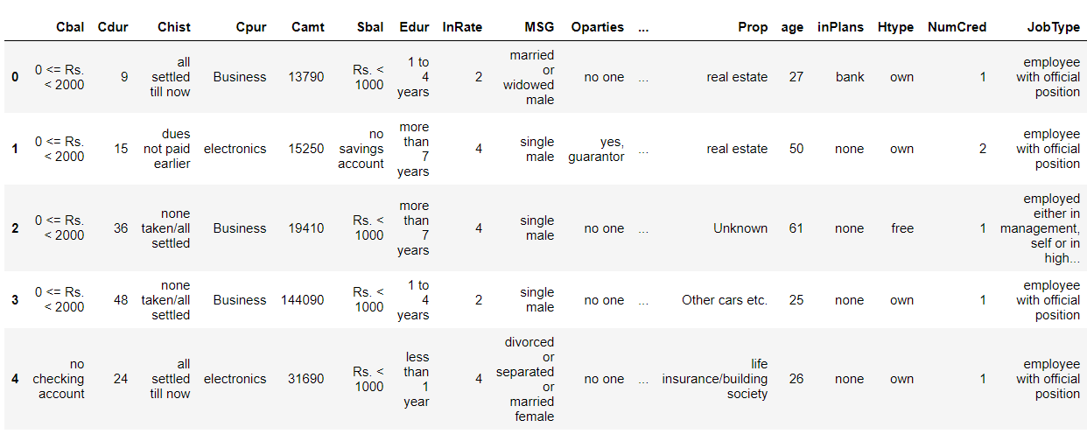
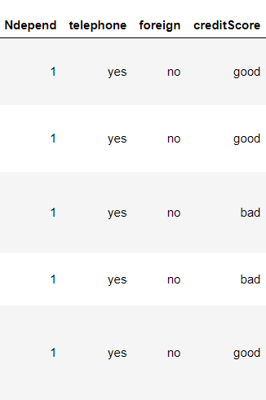
Glimpse of data

Slide 8
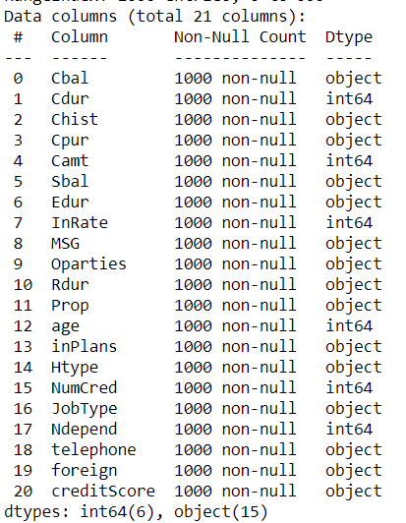
Details about data
The data contains 6 numerical values and 15 categorical variables

Slide 9
Details about missing values
The data does not have any missing values

Slide 10
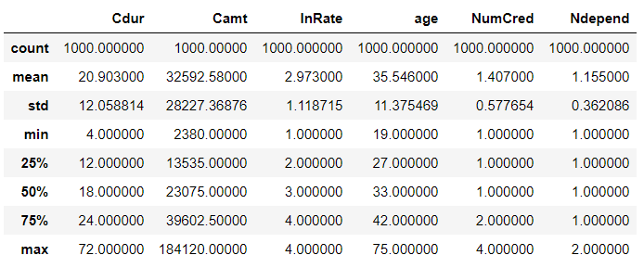
Statistical summary of the data

Slide 11
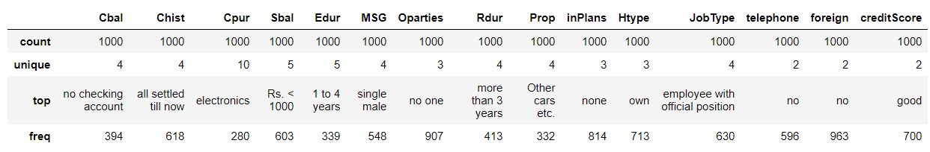
Statistical summary of the data

Slide 12
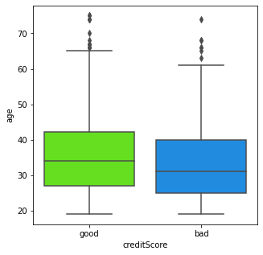
Data exploration
It is evident from the figure that older people have good credit score

Slide 13
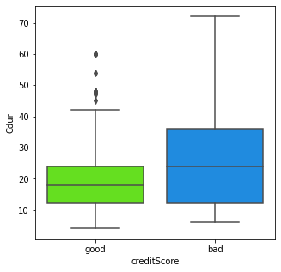
Data exploration (..contd)
The borrowers with higher duration of credit has bad credit score

Slide 14
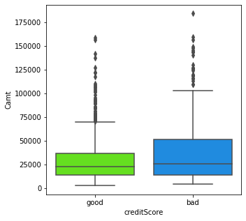
Data exploration (..contd)
The percentage hike in salary does not have any impact on employee leaving the company

Slide 15
Data pre-processing
The data need to be mapped as the features has results in the form of ‘Good’ or ‘Bad’.
We will map ‘Good’ as 1 and ‘Bad’ as 0.
We need to hot encode the categorical variables before processing through the machine learning algorithm

Slide 16
Train and test data
Before separating the data into train and test data, we split target variable as Credit score and rest as input feature to our model
For train data, we took 75 percent of the data
For test data, we took 25 percent of the data

Slide 17
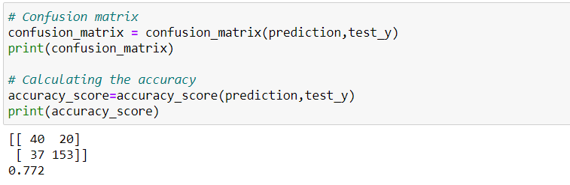
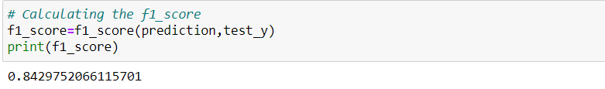
Results from Logistic Regression
The accuracy obtained is 77.20 %
The $F_{1}$ score obtained is 84.29 %. This shows that our model is doing good

Slide 18
Conclusion
Logistic Regression is the simplest model and performed better for our analysis.

Slide 19
THANK YOU

